Slide 1

GLOBAL SALES PERFORMANCE
-DILEEP PATTED

Slide 2
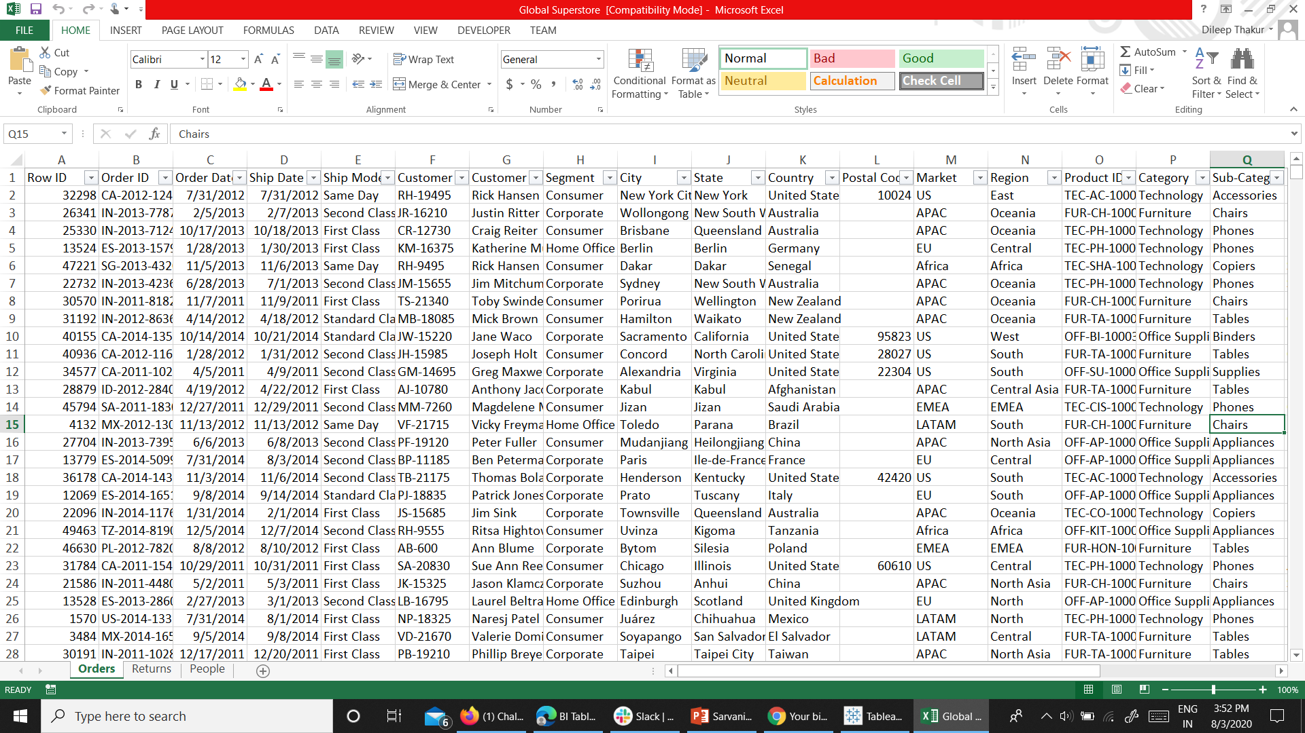
DATASET
I TOOK THIS DATASET FROM DATA.WORLD
This has 25 columns and 51,290 rows

Slide 3
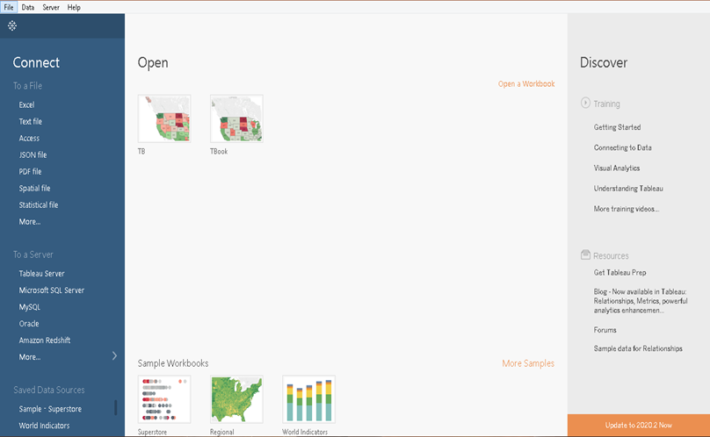
We need to save the dataset and then extract this data in tableau.

Slide 4
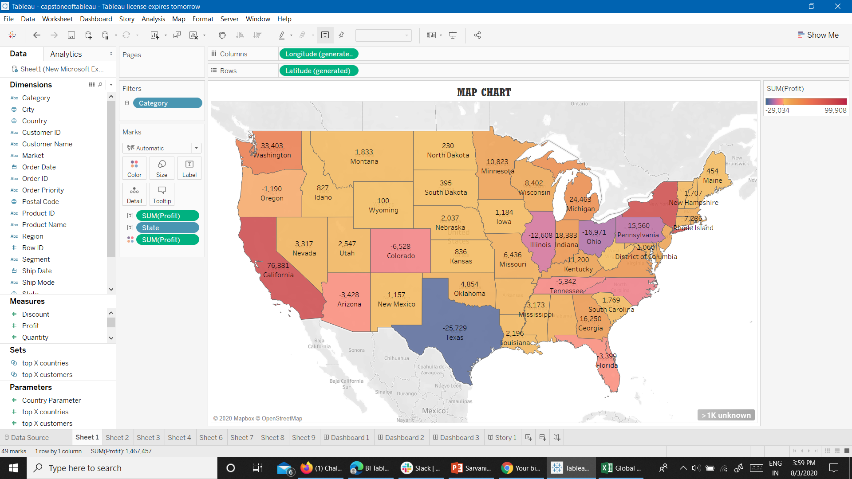
IN THIS MAP CHART , I HAVE CALCULATED PROFITS BY EACH STATE.
CALIFORNIA TOPS THE LIST BY 76,381$

Slide 5
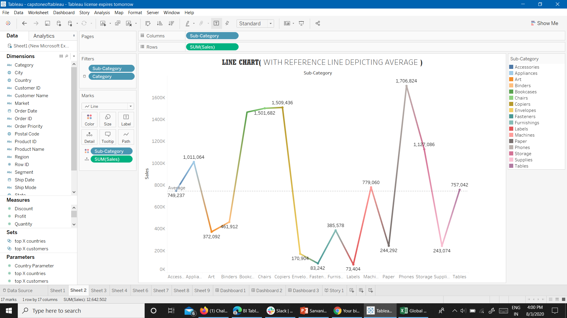
THIS LINE CHART SHOWS THE SUB-CATEGORY WISE SALES.
PEOPLE USUALLY SPEND A LOT OF AMOUNT ON THEIR PHONES, AS SALES ARE HIGHEST FOR PHONES.

Slide 6
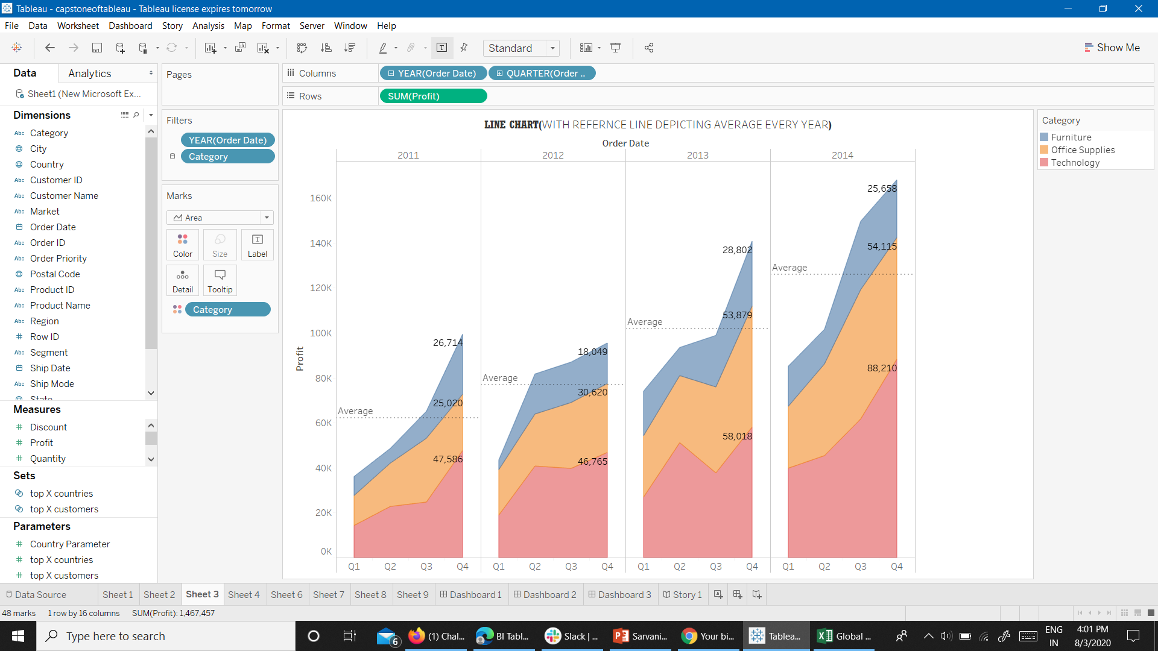
THIS AREA CHART SHOWS QUARTERLY PROFITS OF THE STORE WITH RESPECT TO CATEGORY.
A LOT OF PROFIT IS GAINED BY THE TECHNOLOGY GADGETS.

Slide 7
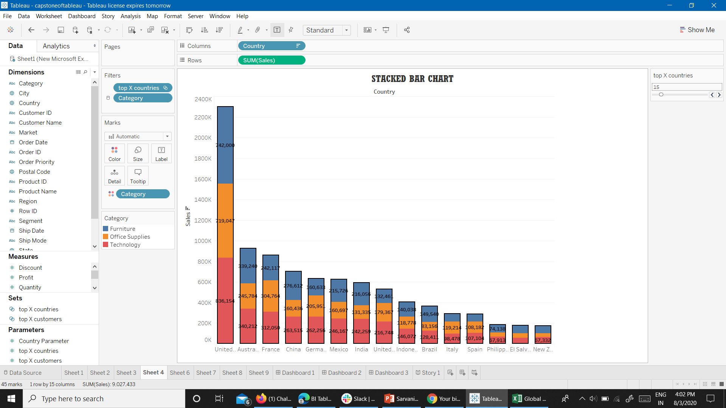
THIS STACKED BAR CHART SHOWS CATEGORY WISE SALES IN DIFFERENT COUNTRIES.
THE SALES OF USA ARE HIGHEST COMPARED TO ANY OTHER COUNTRY IN THE WORLD.

Slide 8
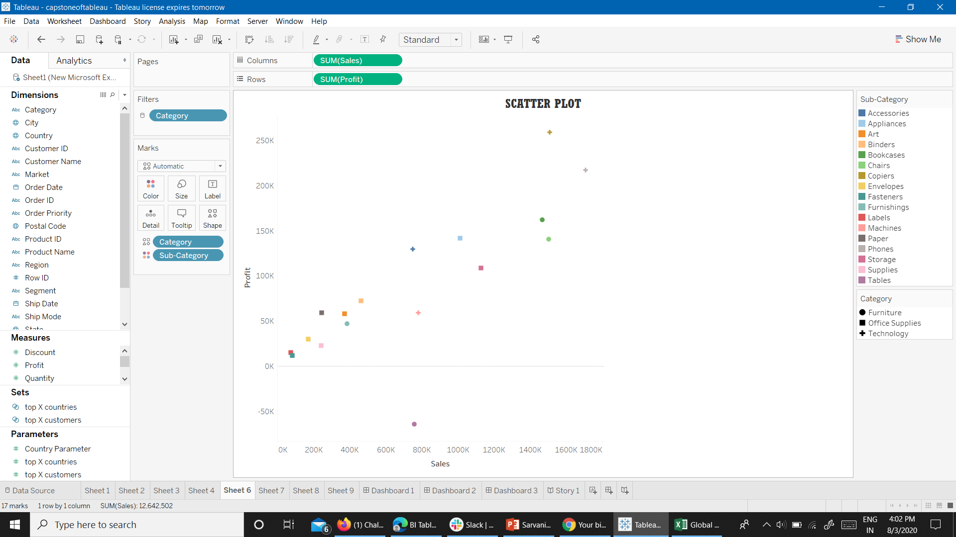
THIS SCATTER PLOT SHOWS THE PROFIT AND SALES (BOTH) OF A PARTICULAR PRODUCT TYPE.

Slide 9
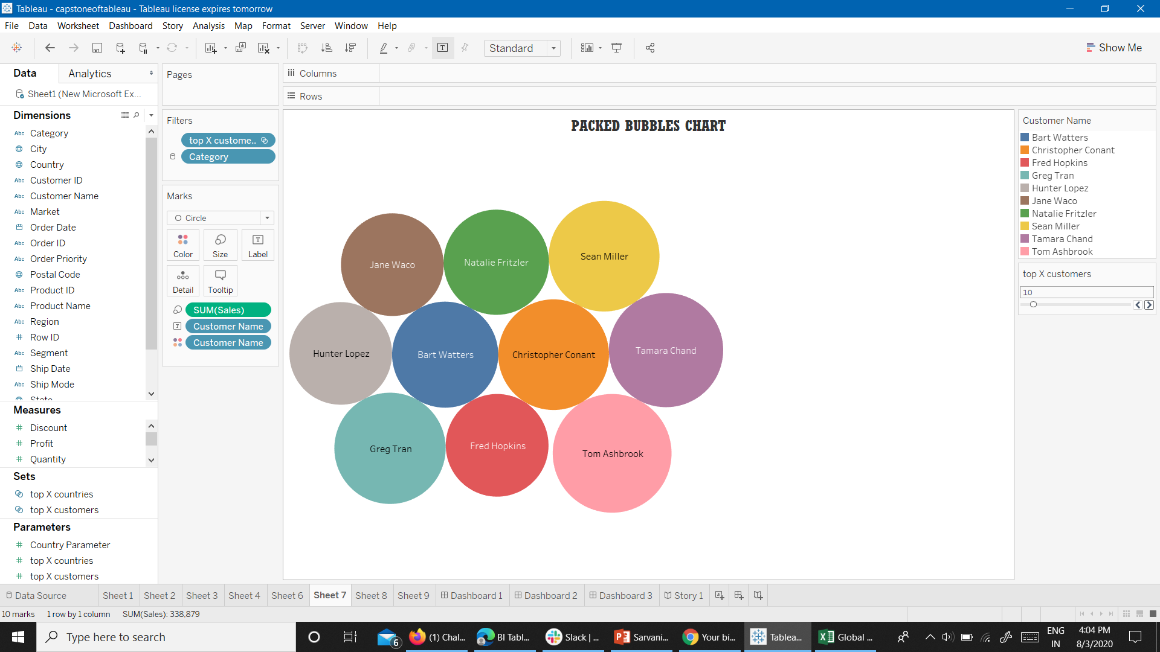
THIS BUBBLE CHART SHOWS WHICH CUSTOMER GIVES THE HIGHEST SALES TO THE FIRM.

Slide 10
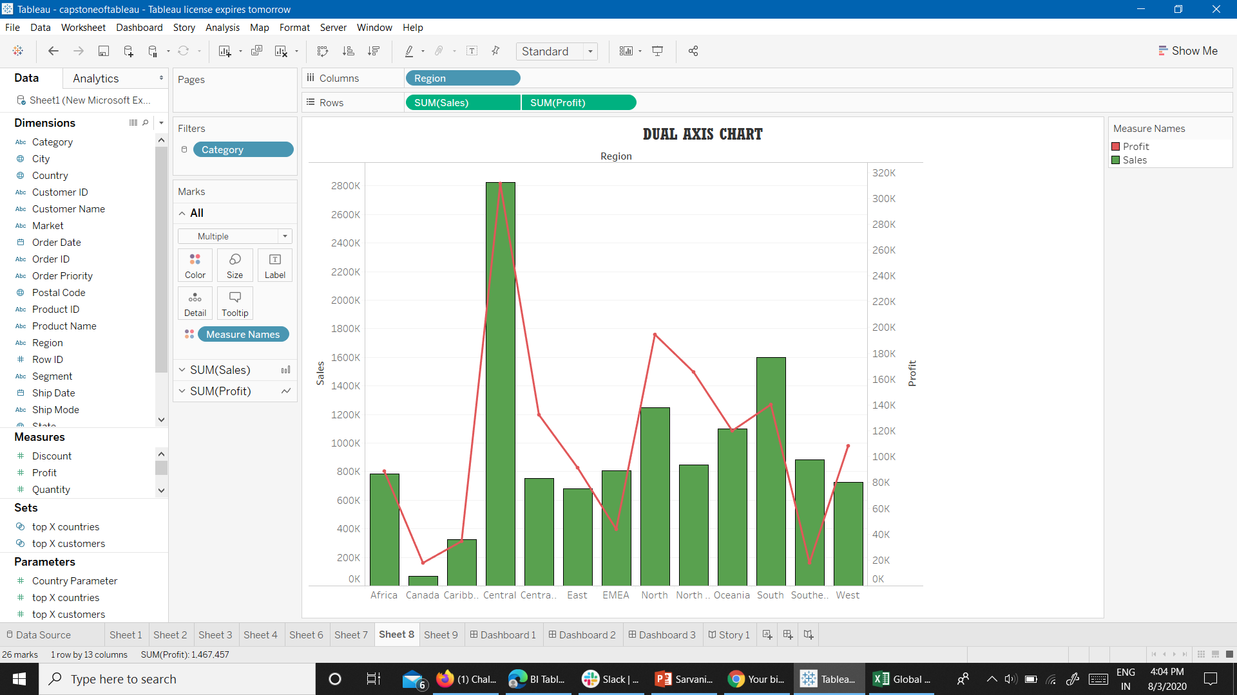
FROM THIS DUAL AXIS CHART I WANT TO COMPARE REGION WISE SALES AND PROFIT.

Slide 11
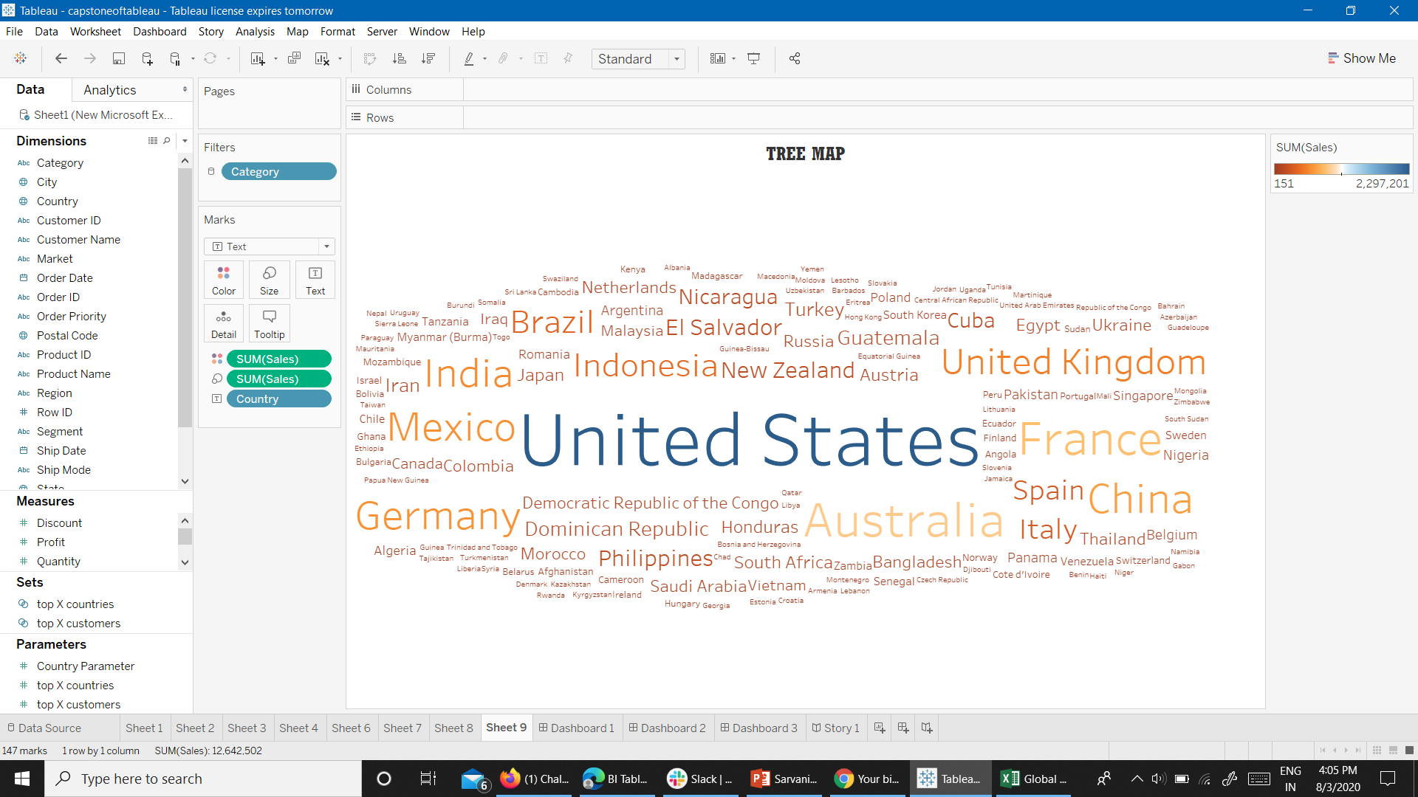
FROM THIS TREE MAP I WANT TO SHOW THE SALES FROM EACH COUNTRY.

Slide 12
PROBLEM STATEMENTS
FROM THE MAP CHART,
IN USA, WHICH STATE HAS THE HIGHEST PROFIT?
FROM LINE CHART,
WHICH SUB CATEGORY HAS THE HIGHEST SALES?
FROM AREA CHART,
HOW MUCH OF PROFIT GAINED IN EACH QUARTER?

Slide 13
FROM STACKED BAR CHART,
WHICH COUNTRY HAS THE HIGHEST SALES?
FROM PACKED BUBBLES CHART,
WHICH CUSTOMER HAS DONE THE HIGHEST SALES?
FROM DUAL AXIS CHART
WHICH REGION HAS HIGHEST PROFIT WITH RESPECT TO SALES?

Slide 14

DASHBOARD

Slide 15
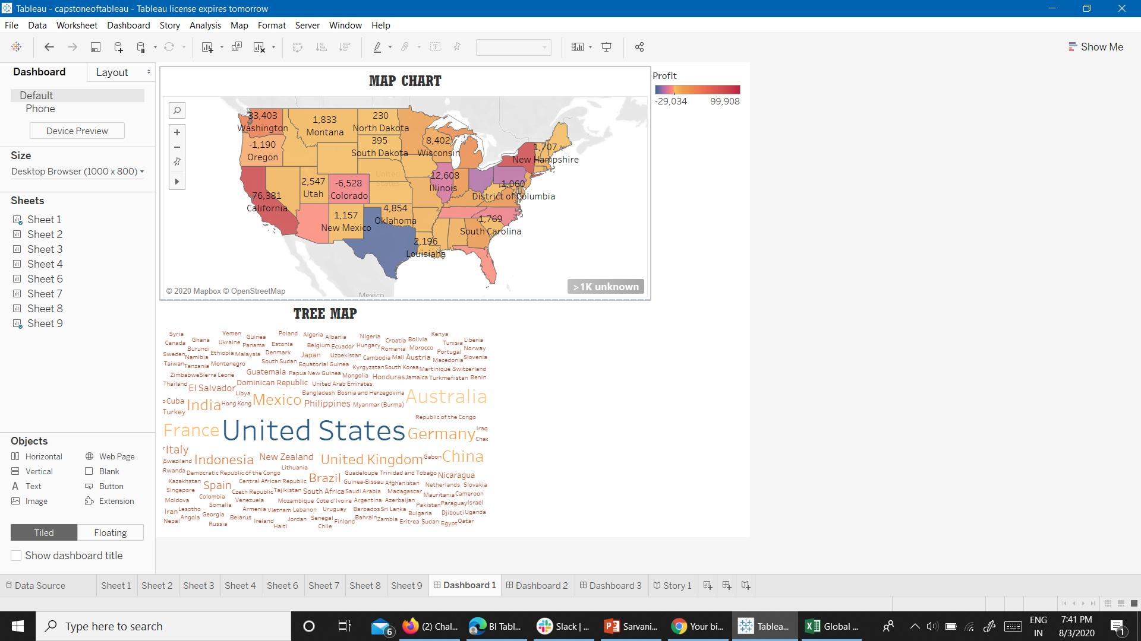

Slide 16
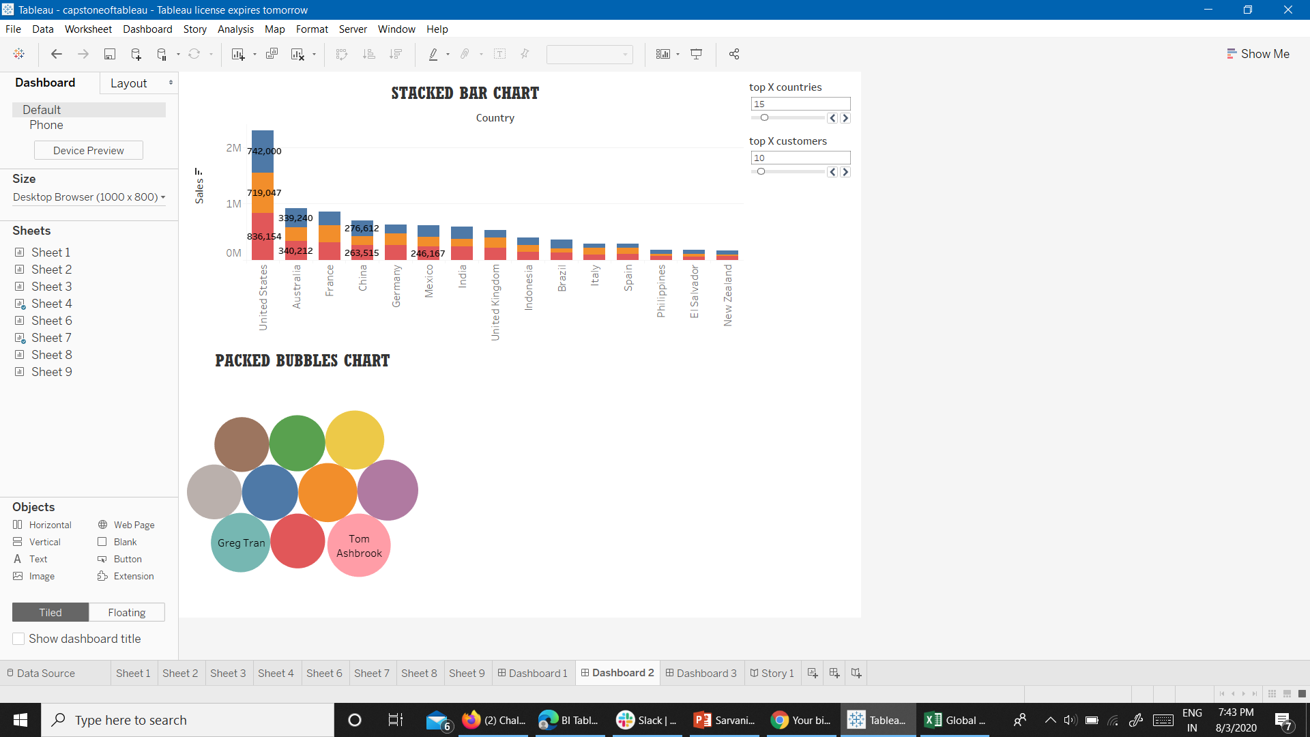

Slide 17
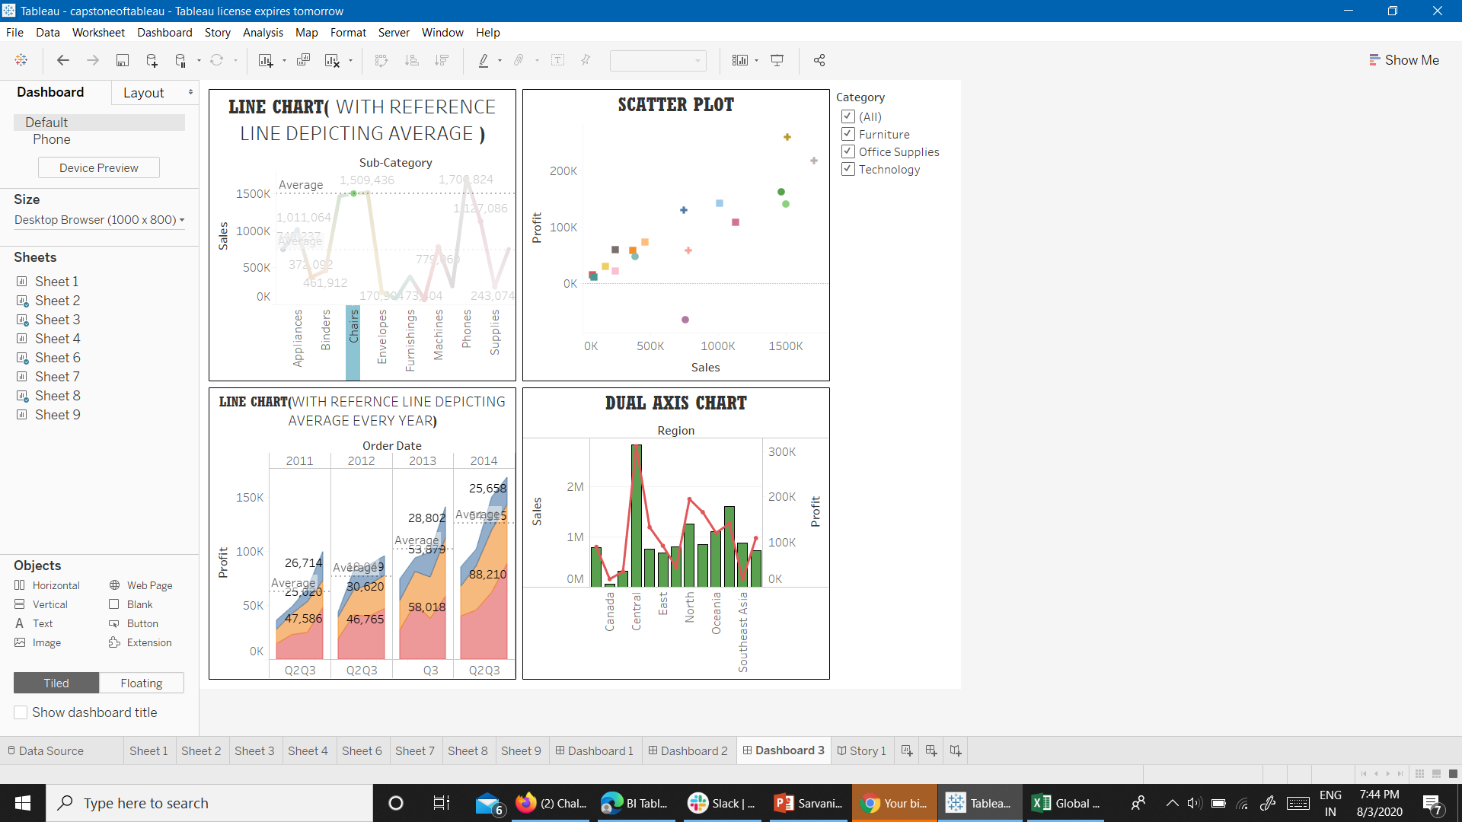

Slide 18
STORY

Slide 19
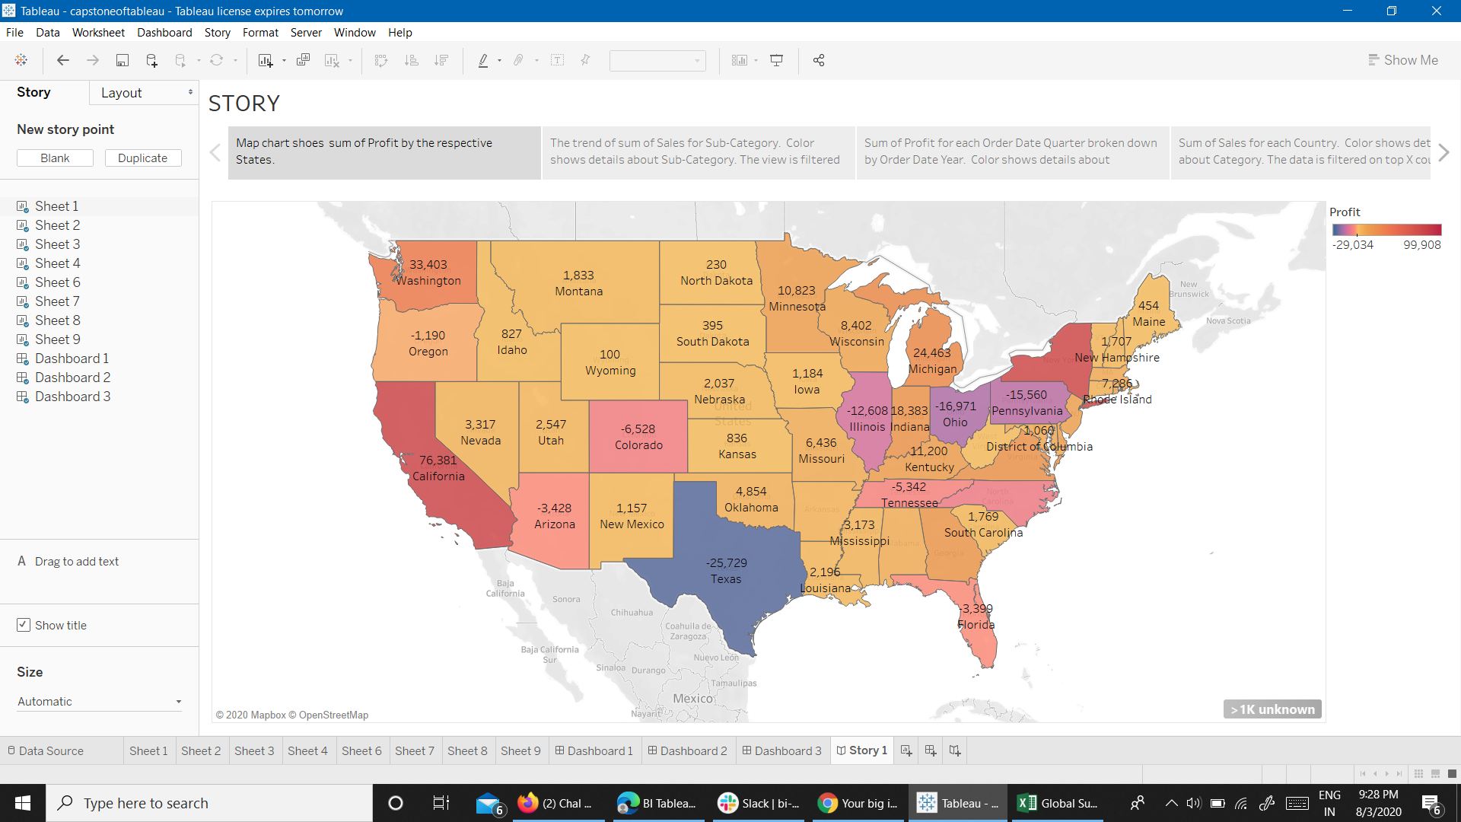
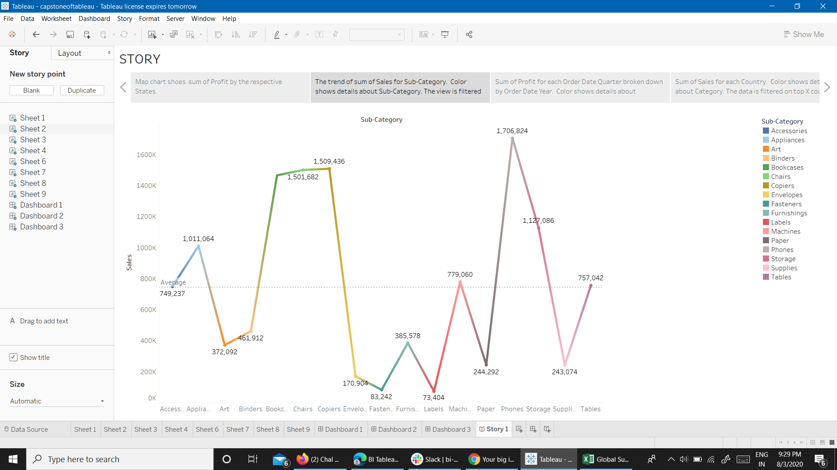

Slide 20
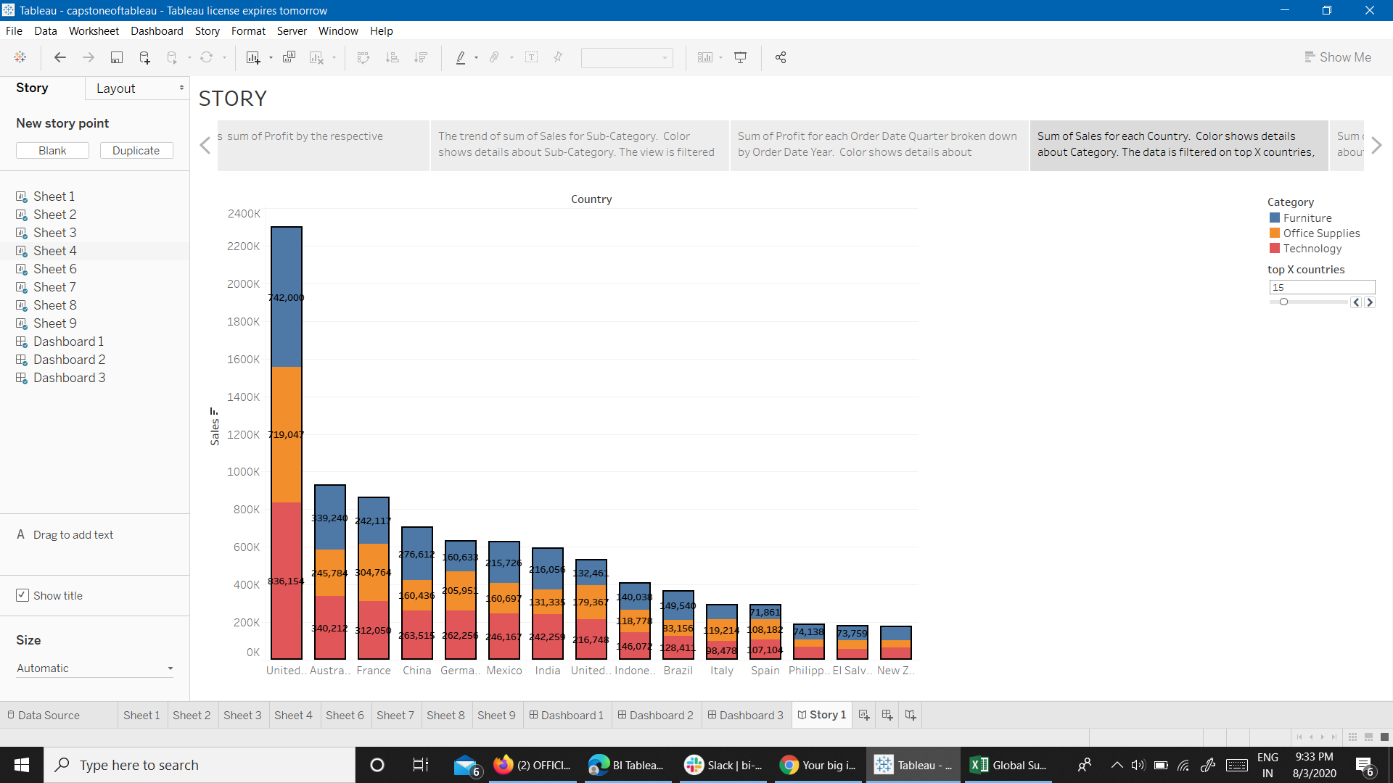
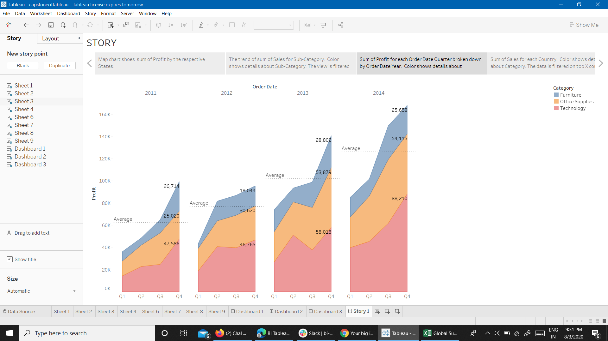

Slide 21
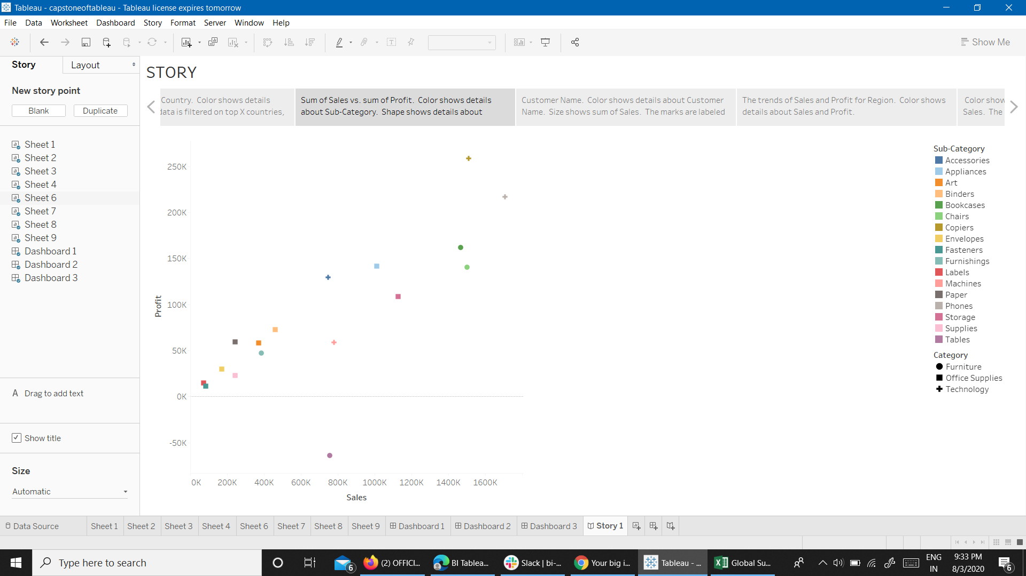
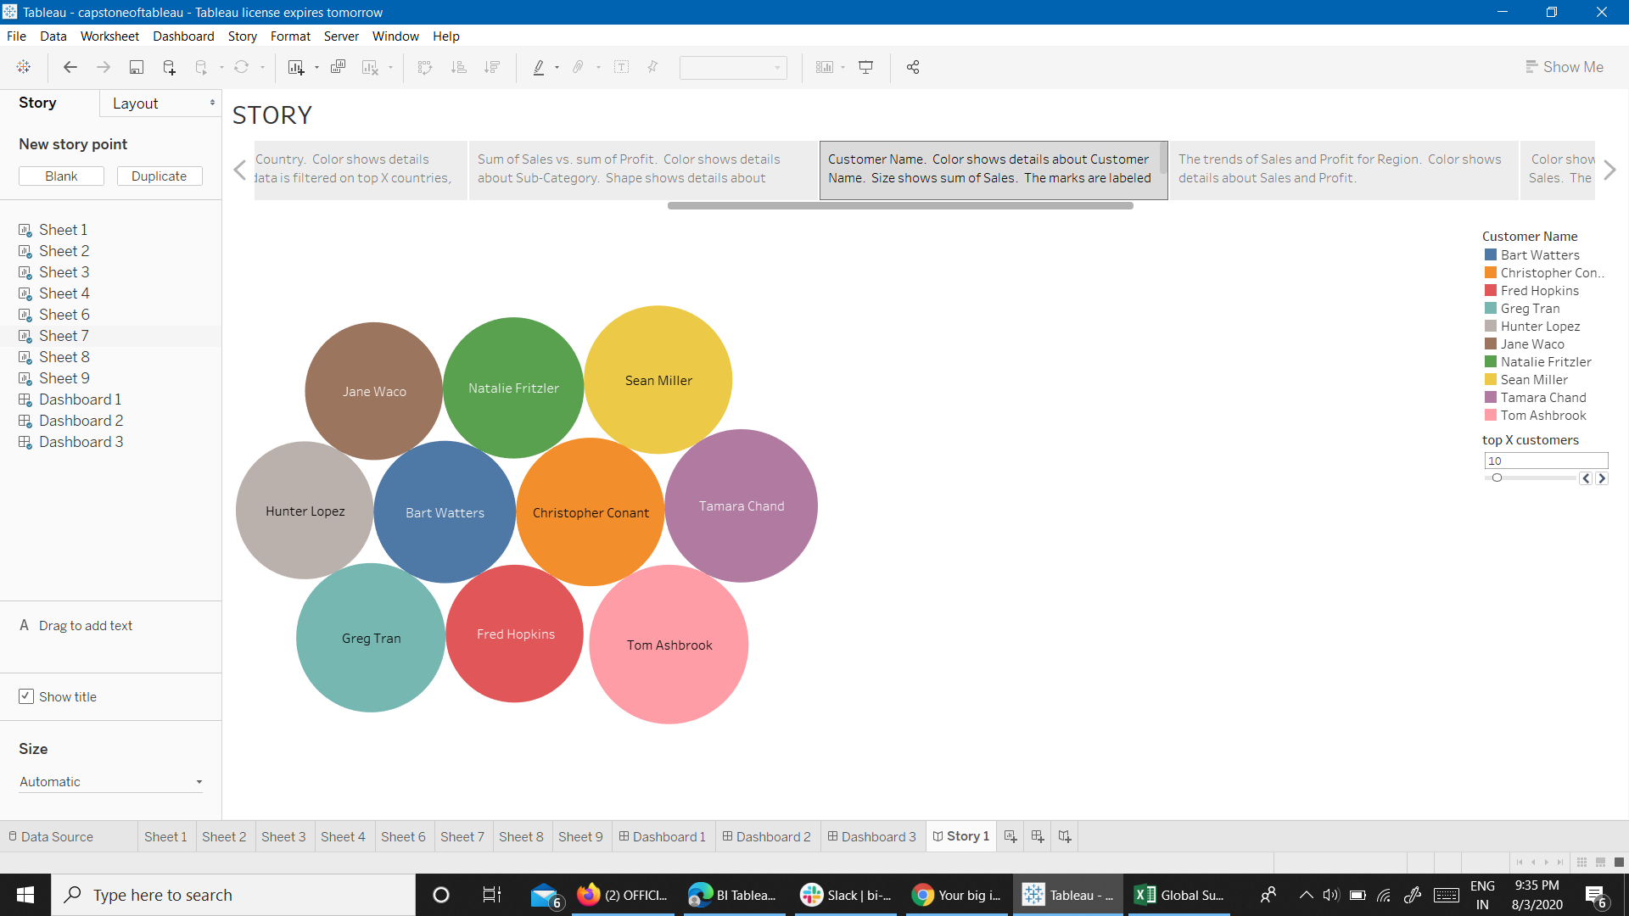

Slide 22
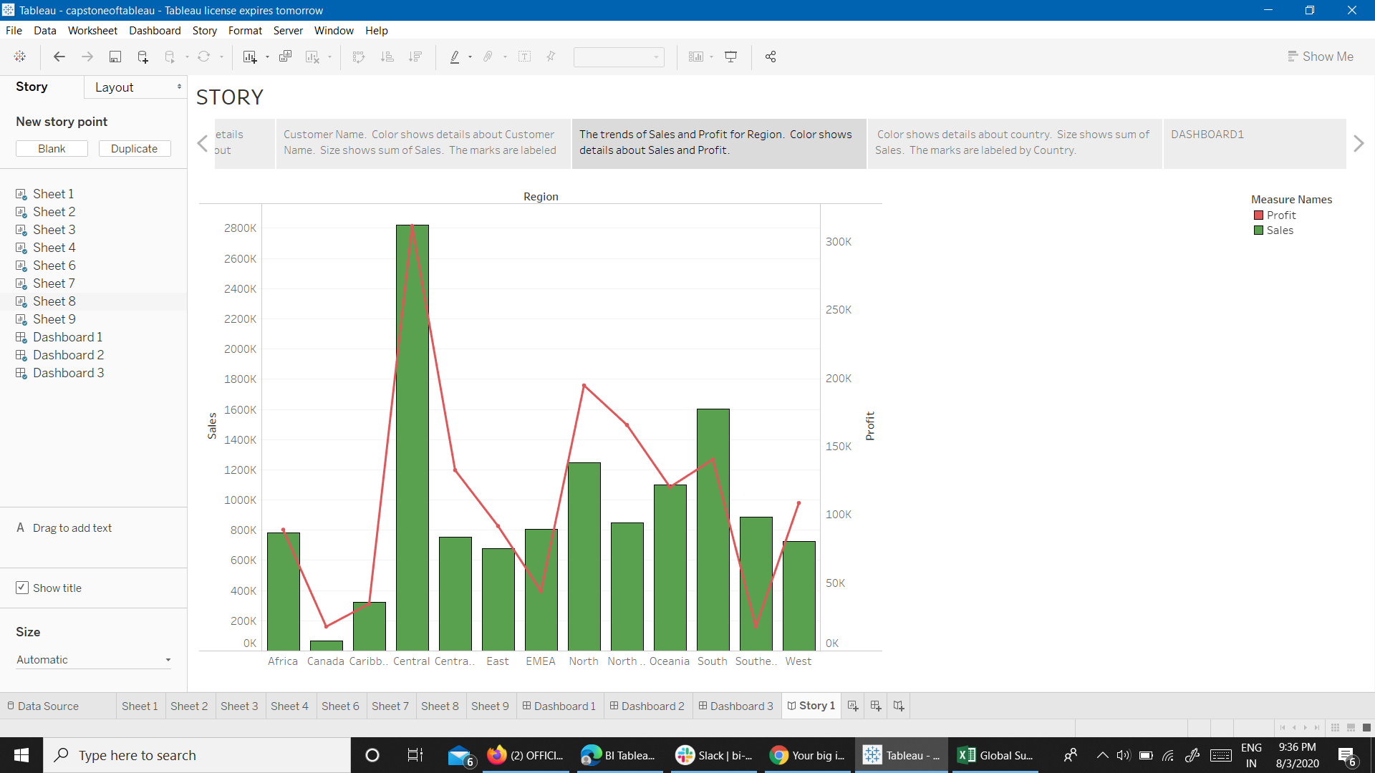


Slide 23

EXECUTIVE SUMMARY
FROM THE MAP CHART, CALIFORNIA TOPS THE LIST BY 76,381$.
FROM LINE CHART, SALES ARE HIGHEST FOR PHONES.
FROM AREA CHART, A LOT OF PROFIT IS GAINED BY THE TECHNOLOGY GADGETS.
FROM STACKED BAR CHART, THE SALES OF USA ARE HIGHEST COMPARED TO ANY OTHER COUNTRY IN THE WORLD.
FROM DUAL AXIS CHART, NORTH REGION HAS GOOD PROFIT COMPARED TO SALES AND SOUTHEAST REGION HAS HUGE LOSS WITH RESPECT TO SALES.

Slide 24

CONCLUSION
THE FIRM OWNER SHOULD SHUT HIS STORES IN SOUTHEAST REGION AS HE IS HAVING A HUGE LOSS IN THAT REGION.
THEY MUST START INVESTING MORE ON TECHNOLOGY STUFF AND ELECTRONIC GADGETS AS THEIR MARKET HUGE FOR THAT AND THEY ARE EARNING HUGE PROFITS FROM THIS SECTOR.

Slide 25
VIDEO LINK- https://drive.google.com/drive/folders/1-5AnAArVPrDCUV3MQ4EpGjJo-fXwpC6l?usp=sharing

Slide 26
 |  |  |  | THANK YOU

